Slide 1
Wild Flowers!
How many do you know?

Slide 2
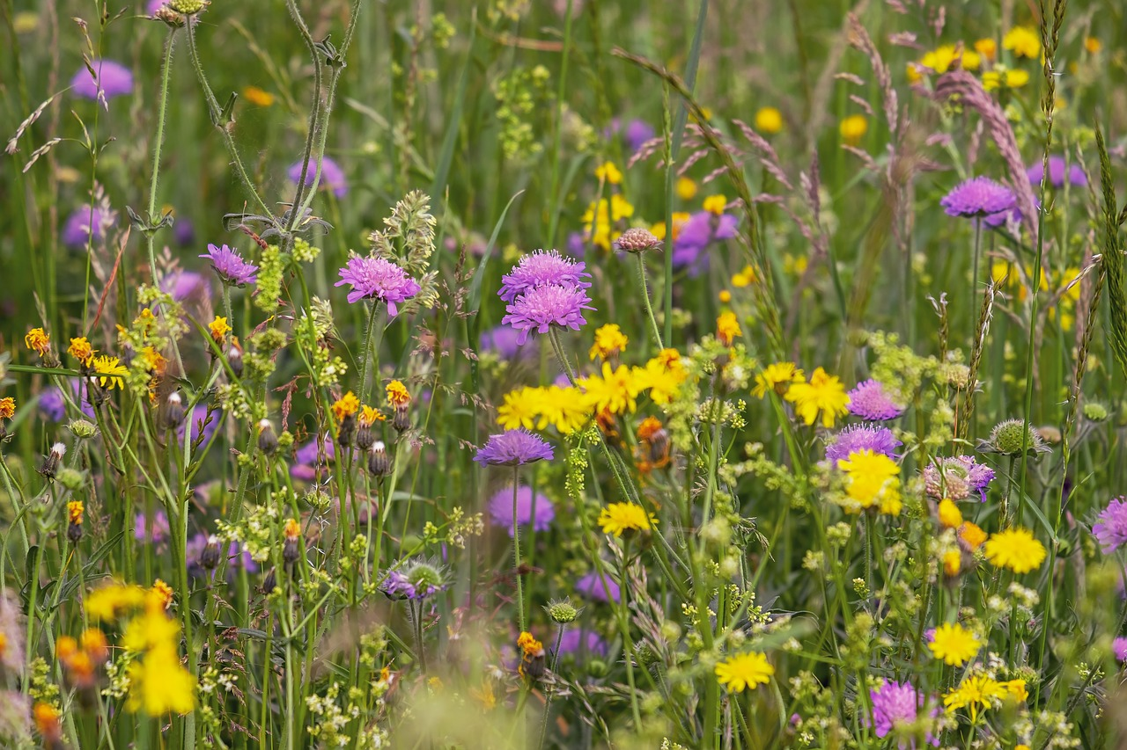
What is a British native tree?
Wild flowers grow naturally in fields and meadows and woods.
British native wild flowers have been growing here for 1000s of years.
Our insects depend on them for pollen, for nectar, for food.

Slide 3
In Harmony Woods, we are planting wild flowers to attract butterflies and bees and other important creatures… and because they are beautiful!

Slide 4
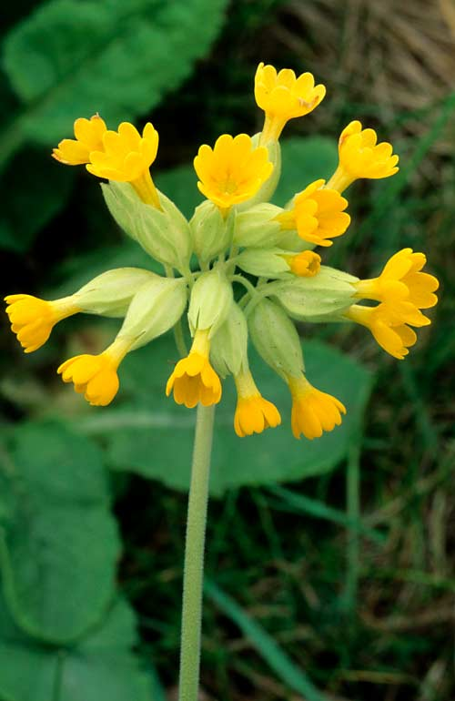
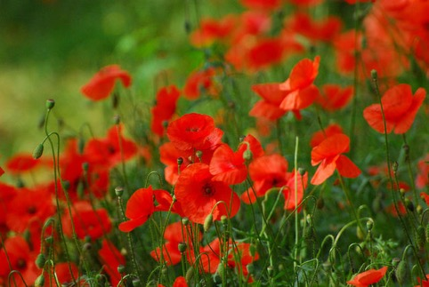
I wonder how many British wild flowers you can think of? Could you name 6?
Count them (use your fingers)
Tell your partner how many
Tell your teacher how many

Slide 5
Do you know what some wild flowers look like? Could you recognise 6?
How many do you think you could recognise?

Slide 6
1.

Slide 7
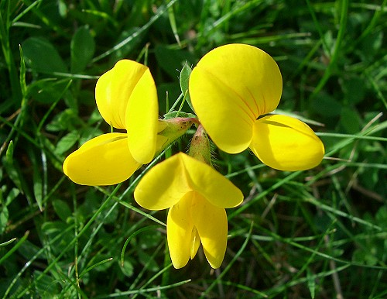
2.

Slide 8
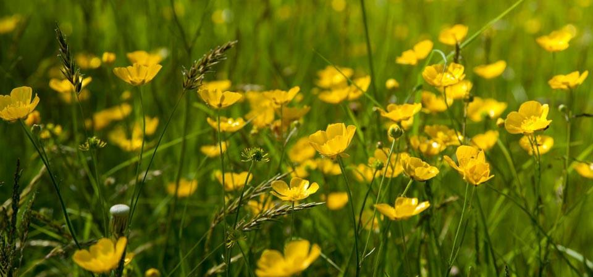
3.

Slide 9
4.

Slide 10
5.

Slide 11
6.

Slide 12
7.

Slide 13
8.

Slide 14
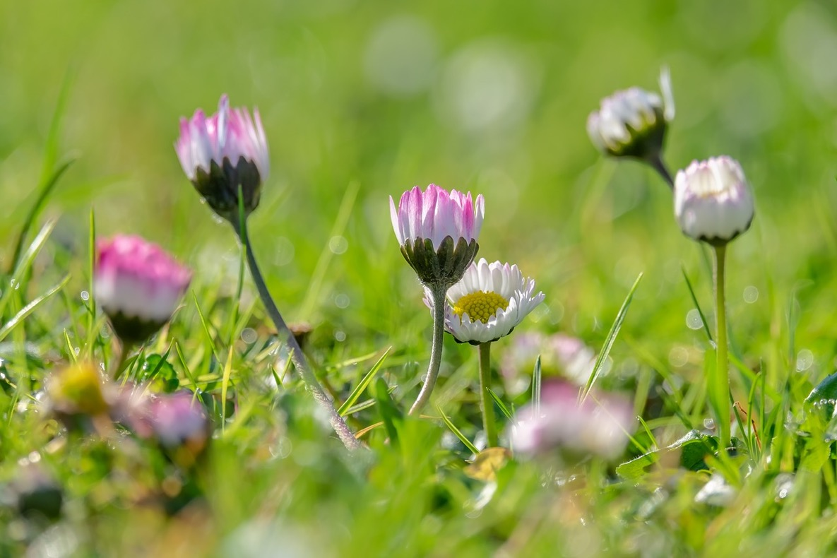
9.

Slide 15
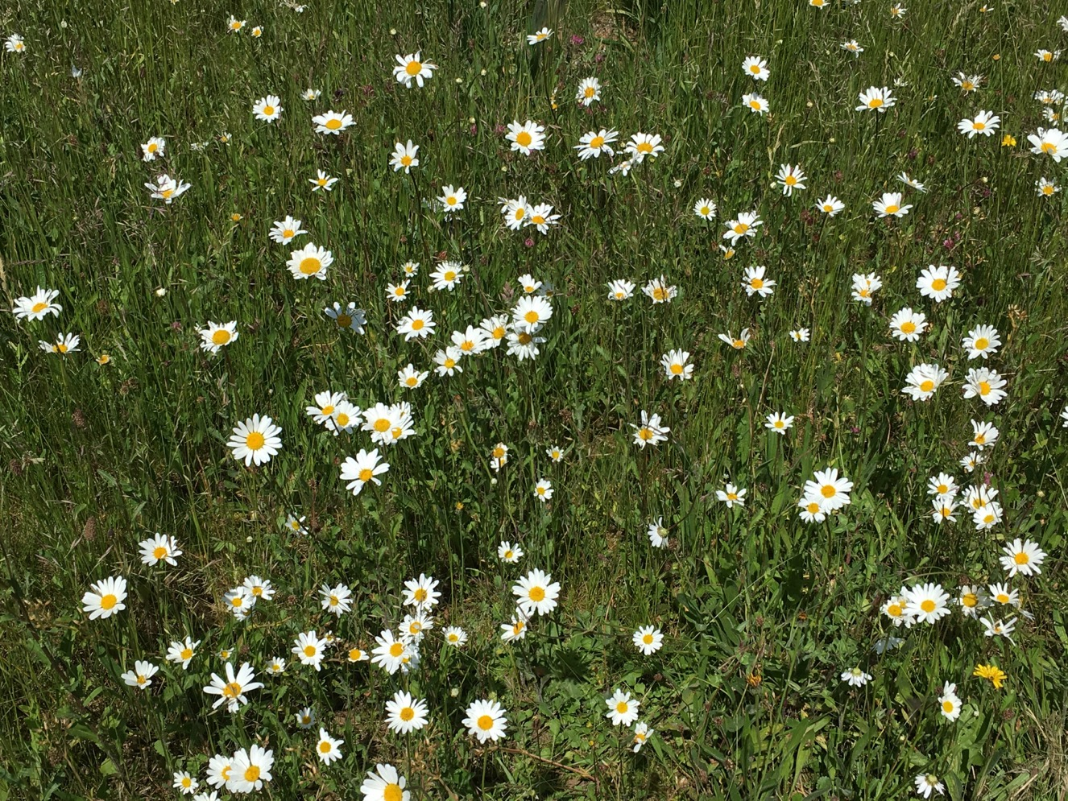
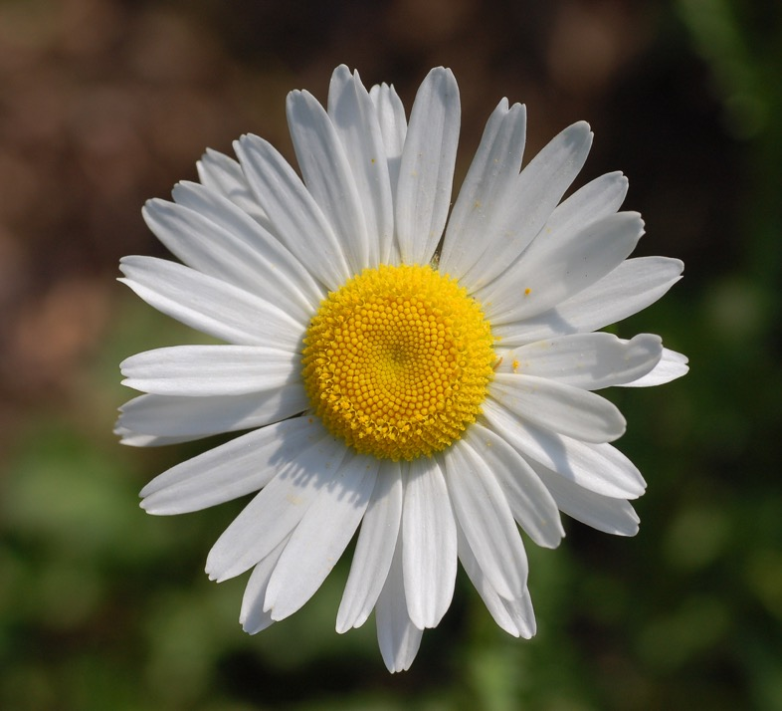
10.

Slide 16
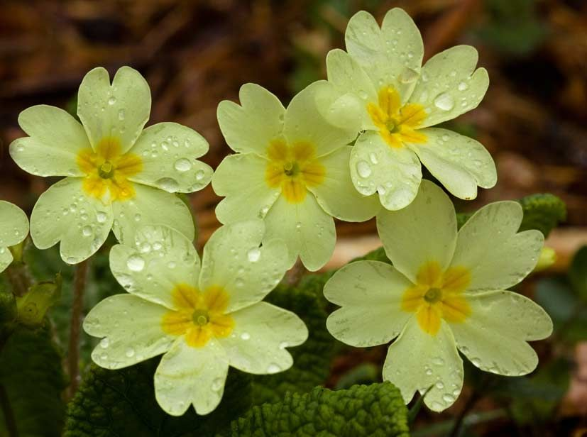
11.

Slide 17
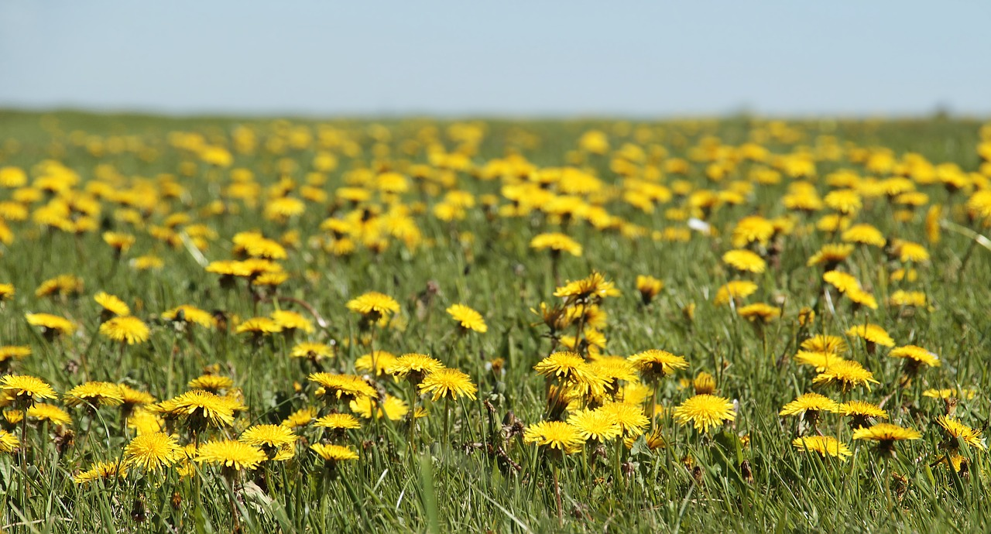
12.

Slide 18
These 6 wild flowers are special to us here in Andover because they love growing on chalk soils – which is what we have here
Common chalk downland wild flowers

Slide 19
Can you remember our names?

Slide 21
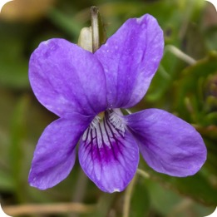
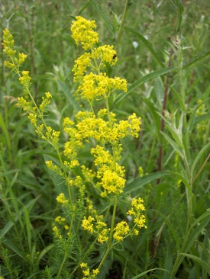
Thank you for doing our quiz
You are going to be doing lots of games and activities to help you to learn to
identify British wild flowers.
Your target is to know these 6 flowers special to your local area!
(Let’s see how many you can remember already!)
Could you beat that target and learn to recognise more than 6?
Birdsfoot trefoil
Dog violet
Ox-eye daisy
Primrose
Cowslip
Lady’s bedstraw

Slide 22
For teachers’ eyes only!
1. Kidney vetch 9. Daisy
2. Birdsfoot trefoil 10. Ox-eye daisy
3. Buttercup 11. Primrose
4. Poppy 12. Dandelion
5. Dog violet
6. Lady’s bedstraw The six (composite picture left to right):
7. Lesser knapweed Cowslip – Dog violet - Primrose
8. Cowslip Lady’s bedstraw – Ox-eye daisy – Birdsfoot trefoil

